Slide 1
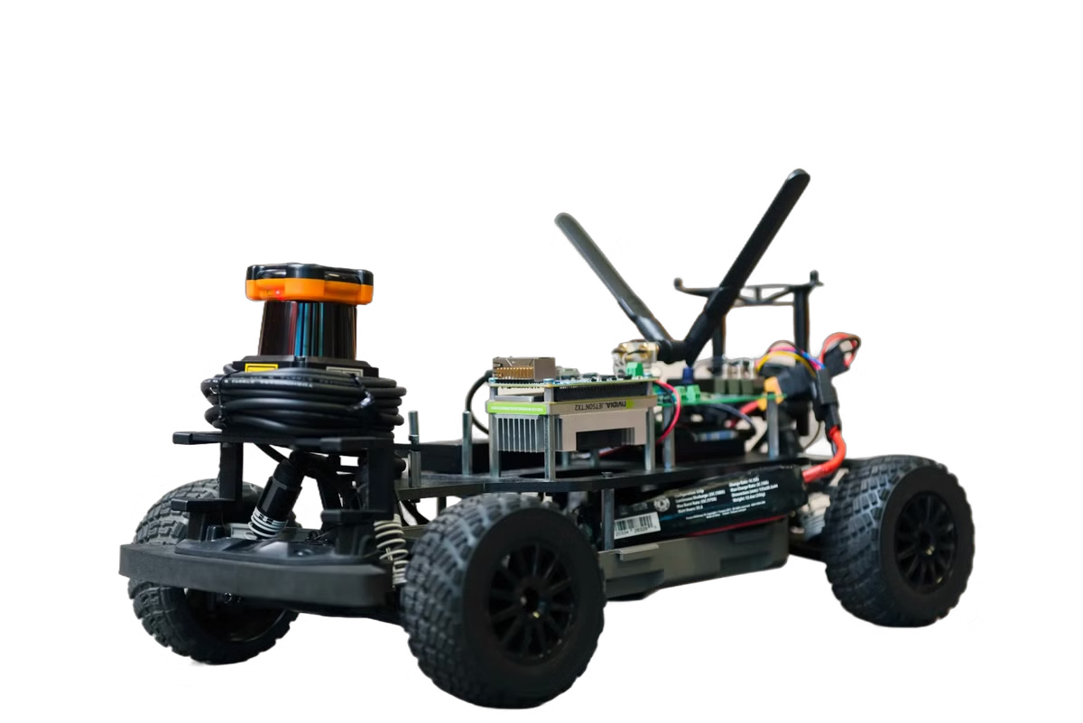
The Autonomous Car Project: Navigating the Future with C Programming
The autonomous car project utilizes C programming to develop a robotic vehicle that navigates its environment while avoiding obstacles. It employs an ultrasonic sensor for real-time distance measurement, enabling the car to detect obstacles and respond by stopping, turning left, or turning right. This project showcases potential applications in delivery systems and assistive technologies for visually impaired individuals, demonstrating effective obstacle avoidance and autonomous navigation..

Slide 2
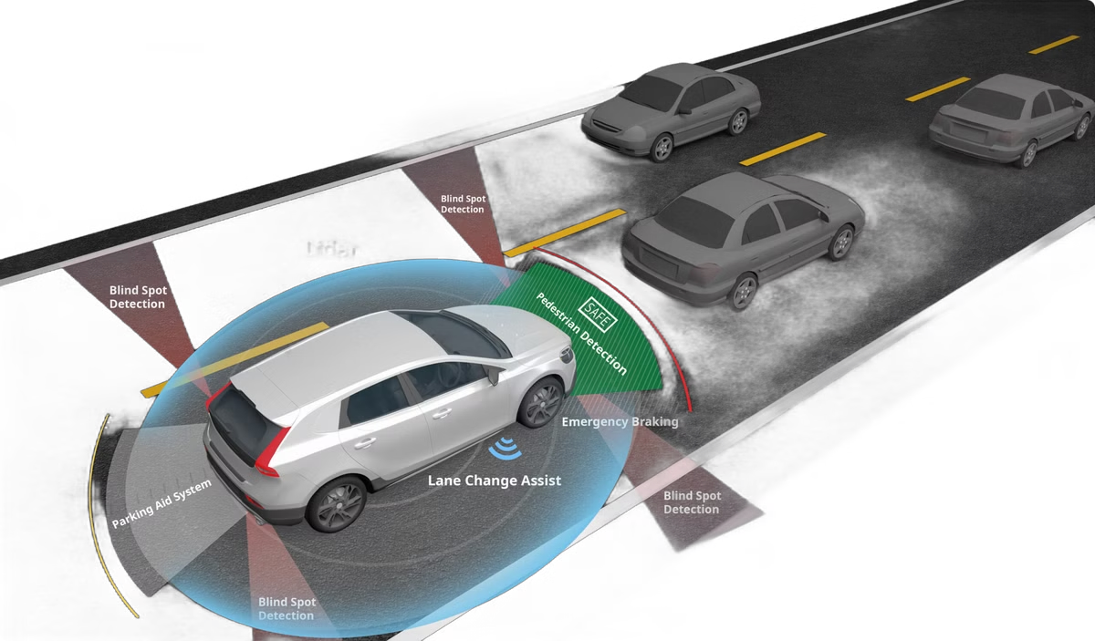
Developing a Robotic Vehicle for Autonomous Navigation
1
Sensor Integration
At the heart of the autonomous car project is the integration of advanced sensors, such as ultrasonic, infrared, and visual sensors, to provide the vehicle with a comprehensive understanding of its surroundings in real-time.
2
Control Systems
Sophisticated control algorithms, programmed in C, are implemented to process sensor data and make decisions about the car's speed, direction, and trajectory, ensuring smooth and safe navigation.
3
Obstacle Avoidance
The car is designed to detect obstacles in its path and respond accordingly, utilizing strategies such as stopping, turning left, or turning right to safely navigate around potential hazards.

Slide 3
Ultrasonic Sensor: Real-Time Obstacle Detection and Distance Measurement
1
Distance Measurement
2
Obstacle Detection
3
Sensor Integration
The ultrasonic sensor plays a crucial role in the autonomous car project, allowing the vehicle to measure the distance to nearby objects in real-time. This data is essential for the car's decision-making process when it comes to navigating safely around obstacles.
By continuously scanning the environment, the ultrasonic sensor can detect the presence of obstacles in the car's path, triggering the necessary responses to avoid collisions and ensure the safety of the vehicle and its occupants.
The ultrasonic sensor's data is seamlessly integrated with the car's control systems, allowing the C programming-based algorithms to make informed decisions about the vehicle's movement and trajectory.

Slide 4

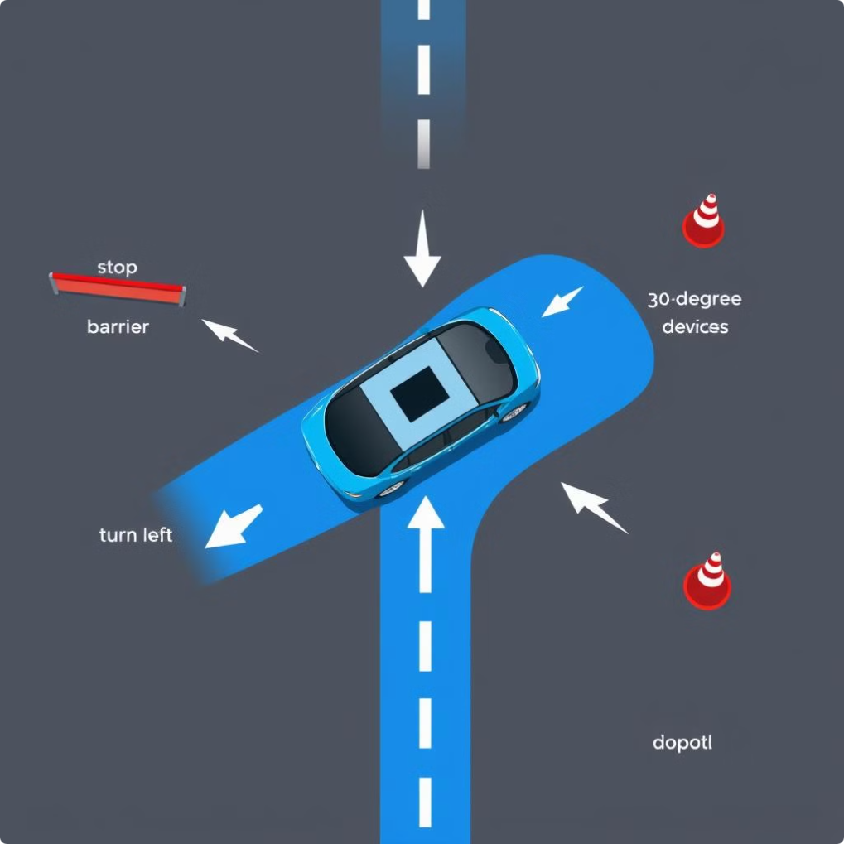




Obstacle Avoidance: Stopping, Turning Left, and Turning Right
Obstacle Detection
The car's sensors continuously scan the environment, identifying potential obstacles in the path.
Stop
When an obstacle is detected, the car's control systems trigger an immediate stop to avoid a collision.
Turn Left
If the obstacle cannot be safely navigated around, the car will turn left to find an alternative path.
Turn Right
Similarly, the car can turn right to avoid the obstacle and continue its journey safely.

Slide 5
Software Architecture: Integrating Sensor Data and Control Systems
Sensor Data Integration
Control System Integration
Adaptive Decision-Making
The software architecture of the autonomous car project leverages C programming to seamlessly integrate data from various sensors, including the ultrasonic sensor, to provide a comprehensive understanding of the vehicle's surroundings.
The integrated sensor data is then processed by the control systems, which utilize advanced algorithms written in C to make real-time decisions about the car's speed, direction, and trajectory, ensuring safe and efficient navigation.
The software architecture is designed to be adaptable, allowing the autonomous car to respond dynamically to changing environmental conditions and obstacles, ensuring a robust and reliable performance.

Slide 6

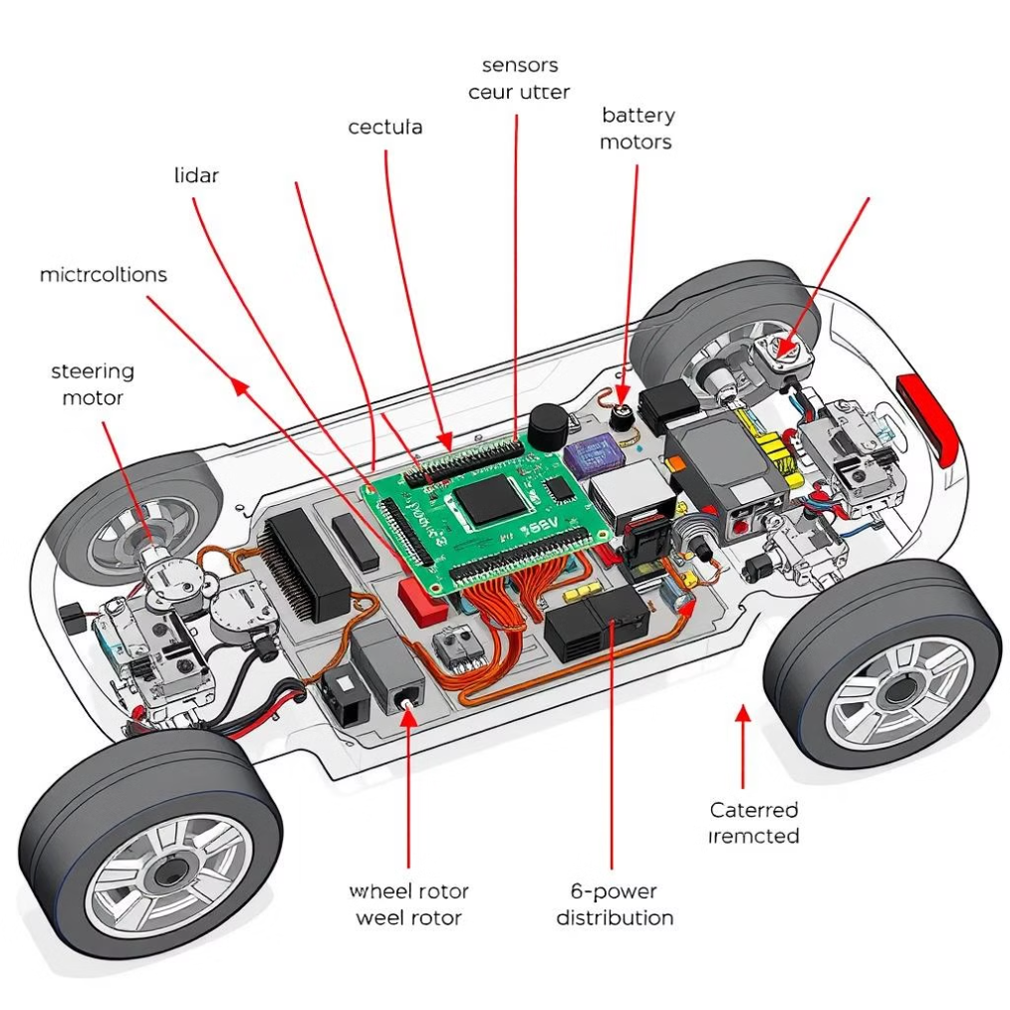
Hardware Components: Selecting Appropriate Microcontrollers and Motors
1
Microcontroller Selection
2
Motor Integration
The autonomous car project utilizes a powerful microcontroller, programmed in C, to serve as the central processing unit, coordinating the various sensors, control systems, and actuation components.
High-performance electric motors are integrated with the microcontroller to provide the necessary propulsion and steering capabilities, allowing the autonomous car to navigate its environment efficiently.
3
Power Systems
The car's power systems, including batteries and power management circuitry, are carefully designed to ensure reliable and sustained operation, enabling the vehicle to traverse various terrains and distances.

Slide 7
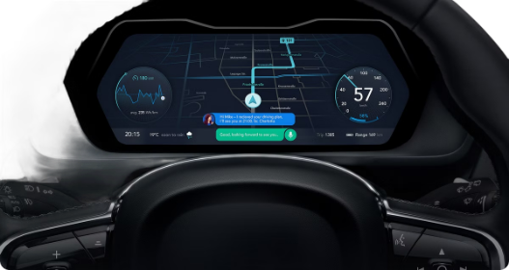



User Interface: Displaying Vehicle Status and Control Options
Speed Monitoring
Sensor Status
Manual Control
The user interface provides real-time information about the car's current speed, allowing the operator to monitor and adjust the vehicle's performance as needed.
The status of the various sensors, including the ultrasonic sensor, is displayed, enabling the user to assess the car's environmental awareness and responsiveness.
The user interface also offers manual control options, allowing the operator to override the autonomous driving mode and directly command the car's movements when necessary.

Slide 8
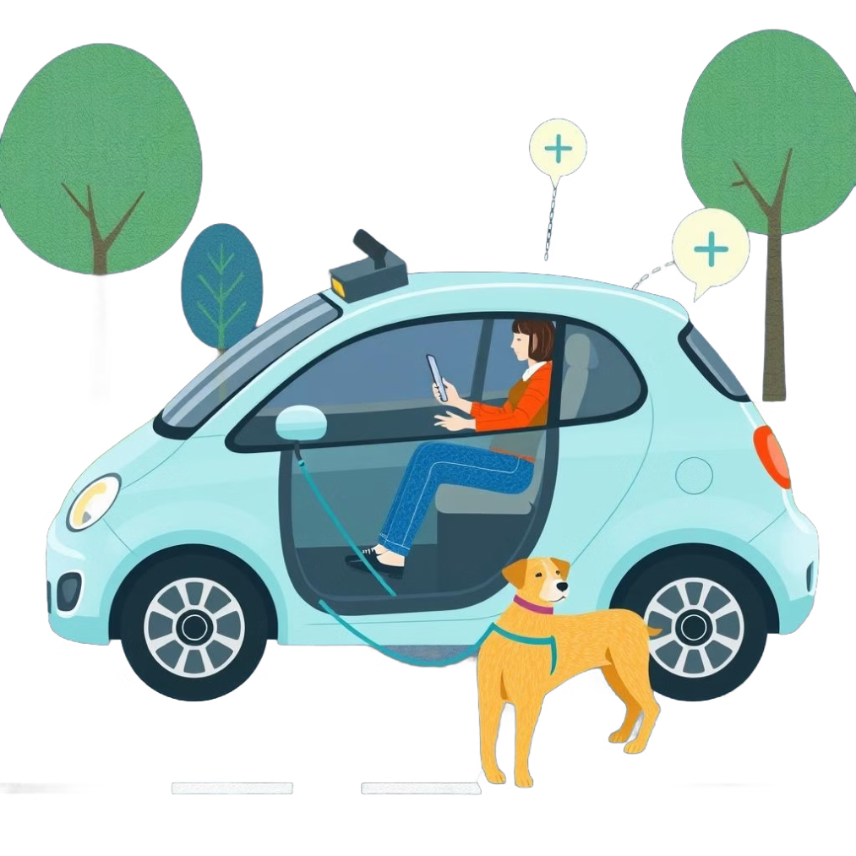
Assistive Technologies: Enhancing Mobility for the Visually Impaired
Voice Commands
Integrated Guidance
The autonomous car project incorporates voice recognition technology, enabling visually impaired users to control the vehicle's movements and access various functionalities through simple voice commands.
The car's sensors and control systems work in tandem to provide real-time guidance and navigation assistance to visually impaired passengers, ensuring a safe and reliable transportation solution.
Accessibility Features
The user interface is designed with accessibility in mind, featuring large, high-contrast buttons, clear audio feedback, and other features that cater to the needs of visually impaired individuals.

Slide 9
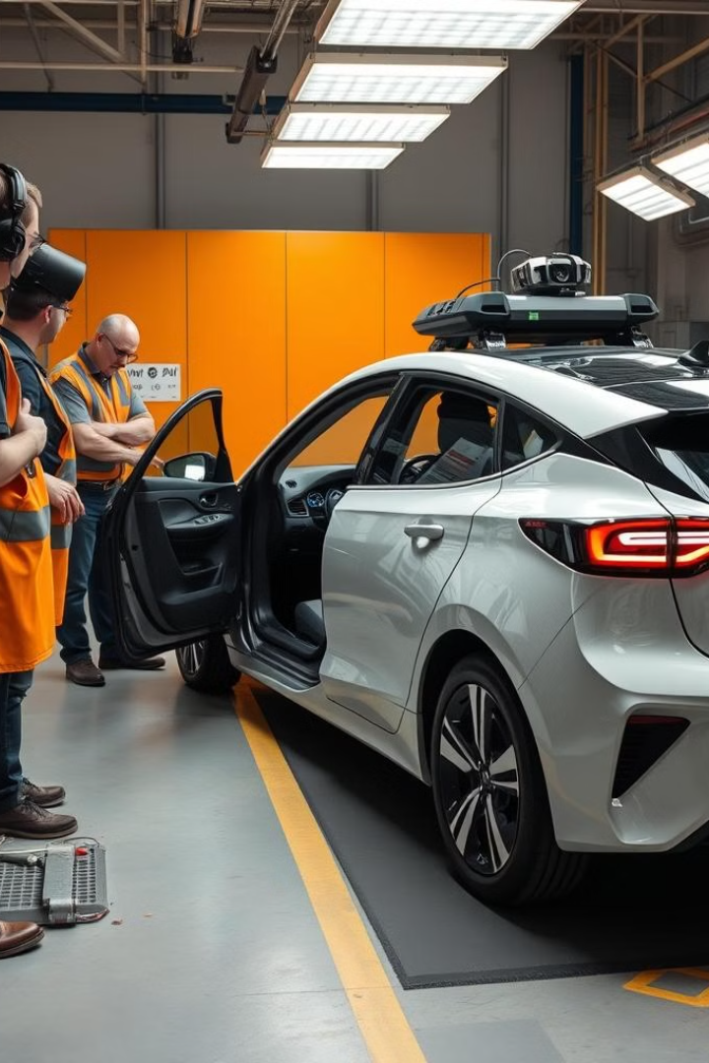
Testing and Evaluation: Ensuring Safe and Reliable Performance
Obstacle Avoidance
Comprehensive testing is conducted to ensure the car's ability to detect and safely navigate around various obstacles, including static and dynamic objects.
Environmental Adaptability
The autonomous car is tested in diverse environmental conditions, such as varying weather, lighting, and terrain, to validate its ability to maintain safe and reliable operation.
Sensor Accuracy
The precision and reliability of the car's sensors, including the ultrasonic sensor, are thoroughly evaluated to ensure accurate data collection and processing.
Control System Responsiveness
The control algorithms, programmed in C, are rigorously tested to verify their ability to make timely and appropriate decisions based on sensor inputs.

Slide 10
Future Developments: Exploring Advancements in Autonomous Driving
Sensor Integration
1
Continuous advancements in sensor technology, including improved ultrasonic, radar, and lidar systems, will enhance the autonomous car's perception capabilities, enabling even more accurate and reliable obstacle detection and navigation.
2
AI-powered Decision-making
The integration of sophisticated AI algorithms, built on a foundation of C programming, will allow the autonomous car to make increasingly complex and contextual decisions, adapting to a wide range of driving scenarios and delivering a more seamless and intelligent driving experience.
Connectivity and Collaboration
3
As autonomous cars become more widespread, the development of vehicle-to-vehicle (V2V) and vehicle-to-infrastructure (V2I) communication protocols will enable cars to share information and coordinate their movements, further enhancing safety and efficiency on the roads.

